Slide 1
FARMER’S BUDDY

Slide 2
INDEX
Abstract
Objective of project
Problem Statement
Scope & Motivation
Introduction
Literature survey
Existing Method
Disadvantages
Proposed method
Advantages
Project Flow
Hardware and Software Requirements
Architecture
Modules
References

Slide 3
ABSTRACT
This abstract outlines the key aspects of a farmer's soil check and addresses the doubts and concerns commonly associated with a farming project. The soil check is a crucial step in understanding the soil's composition and quality, which directly impacts the success and productivity of agricultural endeavors. By conducting a comprehensive soil analysis, farmers can make informed decisions regarding crop selection, fertilization strategies, and overall land management practices. Additionally, addressing doubts and concerns related to farming projects is essential for ensuring optimal planning and execution, as it helps farmers overcome potential challenges and achieve desired outcomes. This abstract provides a brief overview of the significance of soil testing and addresses common doubts faced by farmers during the implementation of farming projects.
Keywords: Farming, Soil checking, questions, answers, Farmer , Panchayath.

Slide 4
OBJECTIVE OF PROJECT
The objective of a farmer's Buddy check is to accurately assess the quality and health of the soil in order to optimize farming practices and improve crop yields. By conducting soil tests, farmers can determine the nutrient content, pH levels, organic matter, and other important parameters that directly impact plant growth. The goal is to provide farmers with actionable information and recommendations to make informed decisions regarding fertilization, irrigation, soil amendments, and crop selection. Ultimately, the objective is to enhance agricultural productivity, promote sustainable farming practices, and ensure long-term soil health

Slide 5
PROBLEM STATEMENT
The current state of the farmer's soil quality assessment is inadequate, leading to suboptimal farming practices and reduced crop yields. There is a lack of accessible and accurate information about the soil composition, nutrient levels, and overall health, making it difficult for farmers to make informed decisions regarding fertilization, irrigation, and crop selection. This knowledge gap not only hampers the farmers' productivity but also has long-term negative implications for the environment and sustainability of agriculture

Slide 6
SCOPE AND MOTIVATION
Motivation:- Understanding the soil's composition and nutrient levels is crucial for maximizing crop productivity. Soil testing provides valuable insights into the availability of essential nutrients, pH levels, and soil structure, enabling farmers to make informed decisions about fertilization and soil management practices. By addressing soil deficiencies and imbalances, farmers can optimize nutrient uptake by plants, leading to healthier crops and increased yields. Addressing doubts and concerns associated with farming projects helps mitigate risks Scope:- The scope of the project "Farmers Buddy" can vary depending on the specific objectives and features of the application. Develop a methodology for proper soil sampling, including determining the sampling locations, depth, and quantity of soil samples needed for accurate analysis. Farmers may question the nutrient status of their soil and how to address nutrient deficiencies effectively.
.

Slide 7
INTRODUCTION
With the mission of enhancing crop yields, promoting sustainable farming methods, and improving overall agricultural outcomes, Farmers Buddy offers a user-friendly platform that serves as a reliable companion for farmers throughout their farming journey. By integrating advanced soil testing, data analysis, and personalized recommendations, Farmers Buddy equips farmers with the knowledge and resources necessary to make informed decisions and optimize their farming practices.
The core features of Farmers Buddy include soil testing and analysis, data management, recommendations and best practices, knowledge sharing, and integration with external services. By conducting soil tests, farmers can assess the quality and health of their soil, understand its nutrient composition, pH levels, and other crucial factors that directly impact crop growth. The platform then provides farmers with tailored recommendations for fertilization strategies, irrigation techniques, and soil amendments based on the specific needs of their soil

Slide 8
INTRODUCTION
Farmers Buddy goes beyond mere data analysis and recommendations by also offering educational resources, tutorials, and access to agricultural experts. This empowers farmers with the necessary knowledge and skills to interpret soil test results accurately and implement sustainable farming practices that improve soil health and fertility.
The project aims to leverage the convenience and accessibility of technology to reach a wide range of farmers, regardless of their location or scale of operations. Farmers Buddy is designed to be user-friendly, with a mobile and web-based interface that simplifies the process of collecting soil samples, conducting tests, and managing data.

Slide 9
LITERATURE SURVEY
S.NO | YEAR | AUTHORS | TITLE | OUT COMES
1 | 2015 | A.T.M Shaikh Ahamed, Navid Tanzeem Mahmod | Applying Data Mining Techniques to predict annual yield of major crop and recommended planting different crops in different Districts in Bangladesh. | This paper proposes an approach of using Hadoop for processing such Big volumes, variety and velocity of weather data. It includes application of Artificial Neural Network which is a convenient approach.
2 | 2015 | Viraj Patodkar1, Sujit Simant2,ShubhamSharma3, Chirag Shah4, Prof. Sachin Godse5 | EAgro Android Application | Agriculture is the backbone of Indian economy as farmers are suffering from huge economic losses. Farmers areconfused to take correct decision regarding selection of fertilizer, pesticides, etc

Slide 10
LITERATURE SURVEY
S.NO | YEAR | AUTHORS | TITLE | OUT COMES
3 | 2015 | Prof.P.B.Gaikwad, Pallavi Malode, Pooja Pawar, Sangita Darade | E-Farming an Interface for Indian Farming | Today the mobile phone is used and in that most are the smart phones. Android is the mobile operating system used in smart phone, most of android applications are freely available for user
4 | 2016 | O. O. Mazhara, S. I. Shapovalovam | Production System for Express Diagnostics of the Agriculture and Natural Resources Objects for Portable Devices | Farmer’s buddy is a java based application for farmers to know which season is better for which crop and what soils are used for crops these are clearly known in this application .

Slide 11
LITERATURE SURVEY
S.NO | YEAR | AUTHORS | TITLE | OUT COMES
5 | 2013 | VCS Agriculture | AFOLU | The basis of this document was the VCS 2007.1, the Guidance for Agriculture, Forestry and Other Land Use Projects and the Tool for AFOLU Methodological Issues
6 | 2014 | Aniket Bhave, Rahul Joshi, Ryan Fernandes | Aniket Bhave, Rahul Joshi, Ryan Fernandes, “Mahafarm An Andriod based solution for remunerative Agriculture” 2014 | This paper describes a mobile based application for farmers which would exhaustively help them in their farming activities. We propose an android based mobile application – ‘MahaFarm’

Slide 12
LITERATURE SURVEY
A college management system is an integrated set of software applications designed to manage various administrative and academic activities in a college. Here are some research papers and articles that can be used for literature survey of college management system project:
This paper presents a system that integrates different modules for managing student records, faculty records, course management, fee management, and other administrative tasks.
The system includes features such as student registration, course management, attendance management, and fee management.

Slide 13
EXISTING SYSTEM
While soil checking provides numerous benefits, there are also some potential disadvantages to consider

Slide 14
DISADVANTAGES
Cost: Soil checking can involve expenses related to soil sampling kits, laboratory testing, and data analysis. The cost of conducting regular soil tests may be a barrier for small-scale or resource-constrained farmers, limiting their access to this valuable information.
Time and Effort: Soil checking requires time and effort to collect soil samples, send them for analysis, and interpret the results. This process can be time-consuming, especially for farmers with large land areas or limited labor resources.
Complexity and Technical Knowledge: Interpreting soil test results and understanding the recommendations can be challenging for farmers with limited scientific or technical knowledge. It may require additional training or support to effectively utilize the information obtained from soil checking

Slide 15
DISADVANTAGES
Limited Scope: Soil checking provides insights into soil nutrient levels, pH, and some other parameters. However, it may not capture all aspects of soil health or factors that can influence crop growth, such as soil microbial activity, organic matter quality, and disease presence. Additional testing or assessments may be required to obtain a comprehensive understanding of soil conditions.
Variability and Sampling Error: Soil characteristics can vary significantly within a field due to factors like topography, soil texture, and management practices. Soil sampling at a few locations may not capture this variability accurately, potentially leading to sampling errors and misrepresentations of the overall soil condition.

Slide 16
PROPOSED METHOD
The "Farmers Buddy" is a proposed system aimed at assisting farmers in various aspects of their agricultural activities. It leverages technology to provide valuable information, resources, and tools to enhance farm management, productivity, and profitability. While the specific features can vary, here are some key components that could be included in the Farmers Buddy system

Slide 17
ADVANTAGES
Optimized Fertilization: Soil checking allows farmers to assess the nutrient levels in their soil accurately. By knowing the nutrient deficiencies or excesses, farmers can apply fertilizers more precisely, avoiding wastage and reducing environmental impact.
Improved Crop Productivity: Soil checking helps farmers understand the soil's pH, organic matter content, and other parameters crucial for crop growth. By optimizing these factors, farmers can improve crop productivity and quality, leading to higher yields and better market value.
Cost Savings: By conducting soil checks, farmers can determine the precise nutrient requirements of their soil. This helps in avoiding unnecessary or excessive fertilization, reducing input costs, and maximizing resource utilization

Slide 18
ADVANTAGES
Environmental Protection: Soil checking helps farmers adopt more sustainable practices by minimizing nutrient runoff and leaching. By applying fertilizers judiciously, farmers can protect water bodies from contamination and reduce the ecological impact of farming.
Applicability of Recommendations: Farmers may have doubts about whether the recommended practices and amendments based on soil test results are suitable for their specific crops, local conditions, and farming systems.

Slide 19
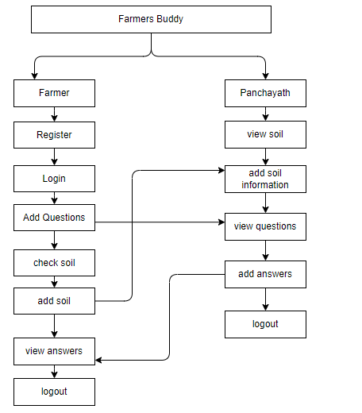
PROJECT FLLOW
Figure: work Flow of Proposed system

Slide 20
HARDWARE & SOFTWARE REQUIREMENTS
SOFTWARE REQUIREMENS
Operating System : Windows 7/8/10
Server side Script : react, CSS, Bootstrap & JS
Programming Language : Node js
Libraries : spring
IDE/Workbench : Intellij

Slide 21
HARDWARE & SOFTWARE REQUIREMENTS
SOFTWARE REQUIREMENS
Technology : java
Server Deployment : tomacat Server
Database : mongodb

Slide 22
HARDWARE & SOFTWARE REQUIREMENTS
HARDWARE REQUIREMENTS
Processor - I3/Intel Processor
RAM - 4GB (min)
Hard Disk - 128 GB
Key Board - Standard Windows Keyboard
Mouse - Two or Three Button Mouse
Monitor - Any

Slide 23
FUNCTIONAL AND NON-FUNCTIONAL REQUIREMENTS
Requirement’s analysis is very critical process that enables the success of a system or software project to be assessed. Requirements are generally split into two types: Functional and non-functional requirements.
Functional Requirements: These are the requirements that the end user specifically demands as basic facilities that the system should offer. All these functionalities need to be necessarily incorporated into the system as a part of the contract. These are represented or stated in the form of input to be given to the system, the operation performed and the output expected. They are basically the requirements stated by the user which one can see directly in the final product, unlike the non-functional requirements.

Slide 24
FUNCTIONAL AND NON-FUNCTIONAL REQUIREMENTS
Examples of functional requirements:
Authentication of user whenever he/she logs into the system
System shutdown in case of a cyber-attack
A verification email is sent to user whenever he/she register for the first time on some software system.
Non-functional requirements: These are basically the quality constraints that the system must satisfy according to the project contract. The priority or extent to which these factors are implemented varies from one project to other. They are also called non-behavioral requirements.

Slide 25
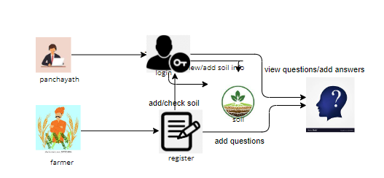
ARCHITECTURE

Slide 26
UML DIAGRAMS
Use Case Diagram:
A use case diagram in the Unified Modeling Language (UML) is a type of behavioral diagram defined by and created from a Use-case analysis. Its purpose is to present a graphical overview of the functionality provided by a system in terms of actors, their goals (represented as use cases), and any dependencies between those use cases. The main purpose of a use case diagram is to show what system functions are performed for which actor. Roles of the actors in the system can be depicted.

Slide 27
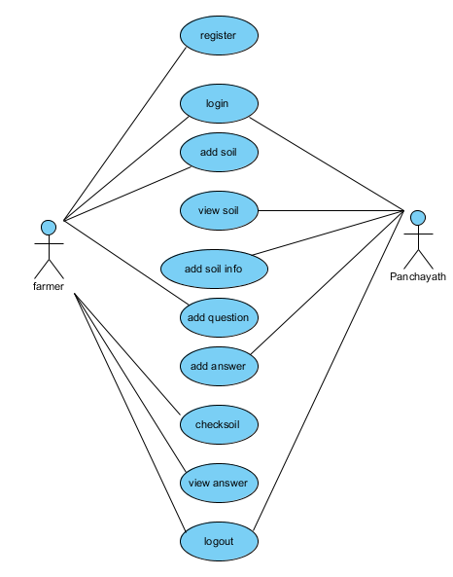
UML DIAGRAMS
Figure: Use Case Diagram

Slide 28
UML DIAGRAMS
Class Diagram:
In software engineering, a class diagram in the Unified Modelling Language (UML) is a type of static structure diagram that describes the structure of a system by showing the system's classes, their attributes, operations (or methods), and the relationships among the classes. It explains which class contains information.

Slide 29
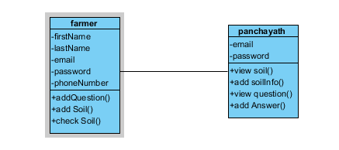
UML DIAGRAMS
Figure: Class diagram

Slide 30
UML DIAGRAMS
Sequence Diagram:
A sequence diagram in Unified Modelling Language (UML) is a kind of interaction diagram that shows how processes operate with one another and in what order. It is a construct of a Message Sequence Chart. Sequence diagrams are sometimes called event diagrams, event scenarios, and timing diagrams.

Slide 31
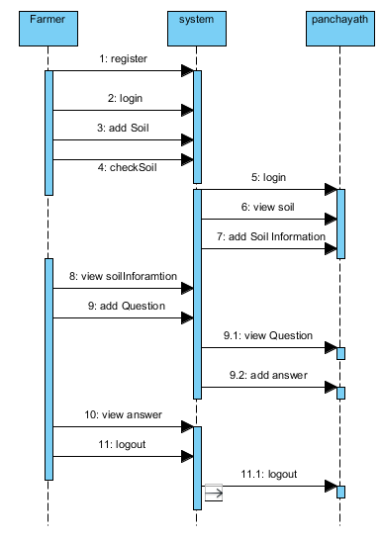
UML DIAGRAMS
Figure: Sequence diagram

Slide 32
UML DIAGRAMS
Collaboration Diagram:
In collaboration diagram the method call sequence is indicated by some numbering technique as shown below. The number indicates how the methods are called one after another. We have taken the same order management system to describe the collaboration diagram. The method calls are similar to that of a sequence diagram. But the difference is that the sequence diagram does not describe the object organization whereas the collaboration diagram shows the object organization.

Slide 33
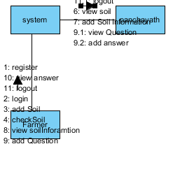
UML DIAGRAMS
Figure: Collaboration diagram

Slide 34
UML DIAGRAMS
Deployment Diagram
Deployment diagram represents the deployment view of a system. It is related to the component diagram. Because the components are deployed using the deployment diagrams. A deployment diagram consists of nodes. Nodes are nothing but physical hardware’s used to deploy the application.

Slide 35
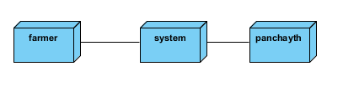
UML DIAGRAMS
Figure: Deployment diagram

Slide 36
UML DIAGRAMS
Activity Diagram:
Activity diagrams are graphical representations of workflows of stepwise activities and actions with support for choice, iteration and concurrency. In the Unified Modelling Language, activity diagrams can be used to describe the business and operational step-by-step workflows of components in a system. An activity diagram shows the overall flow of control.

Slide 37
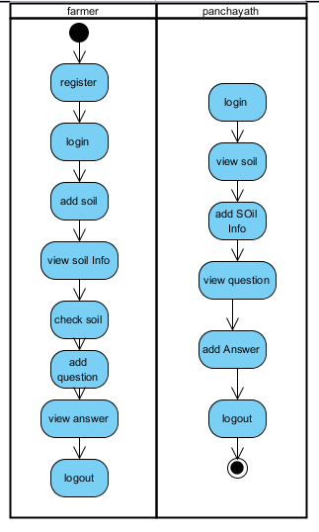
UML DIAGRAMS
Figure: Activity diagram

Slide 38
UML DIAGRAMS
Component Diagram:
A component diagram, also known as a UML component diagram, describes the organization and wiring of the physical components in a system. Component diagrams are often drawn to help model implementation details and double-check that every aspect of the system's required functions is covered by planned development.

Slide 39
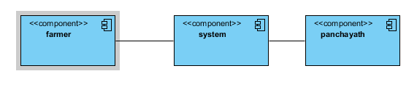
UML DIAGRAMS
Figure: Component diagram

Slide 40
UML DIAGRAMS
ER Diagram:
An Entity–relationship model (ER model) describes the structure of a database with the help of a diagram, which is known as Entity Relationship Diagram (ER Diagram). An ER model is a design or blueprint of a database that can later be implemented as a database. The main components of E-R model are: entity set and relationship set.
An ER diagram shows the relationship among entity sets. An entity set is a group of similar entities and these entities can have attributes. In terms of DBMS, an entity is a table or attribute of a table in database, so by showing relationship among tables and their attributes, ER diagram shows the complete logical structure of a database. Let’s have a look at a simple ER diagram to understand this concept.

Slide 41
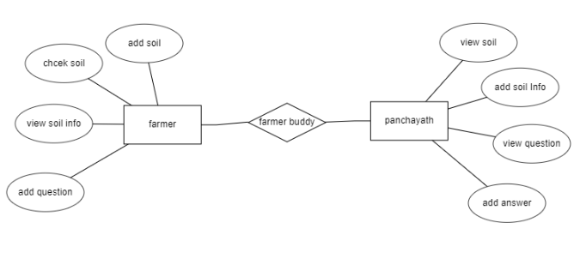
UML DIAGRAMS
Figure: ER diagram

Slide 42
UML DIAGRAMS
DFD Diagram:
A Data Flow Diagram (DFD) is a traditional way to visualize the information flows within a system. A neat and clear DFD can depict a good amount of the system requirements graphically. It can be manual, automated, or a combination of both. It shows how information enters and leaves the system, what changes the information and where information is stored. The purpose of a DFD is to show the scope and boundaries of a system as a whole. It may be used as a communications tool between a systems analyst and any person who plays a part in the system that acts as the starting point for redesigning a system.

Slide 43
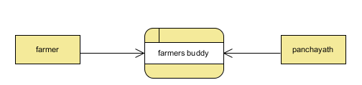
UML DIAGRAMS
Figure: Context Level diagram

Slide 44
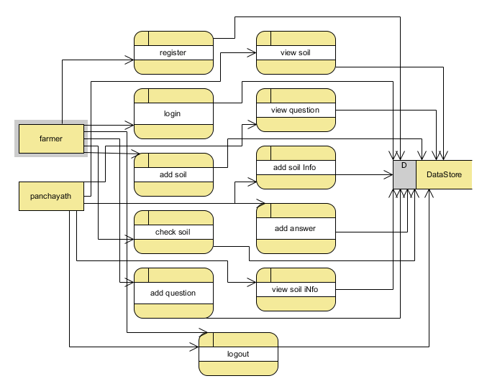
UML DIAGRAMS
FigureLevel-1 diagram

Slide 45
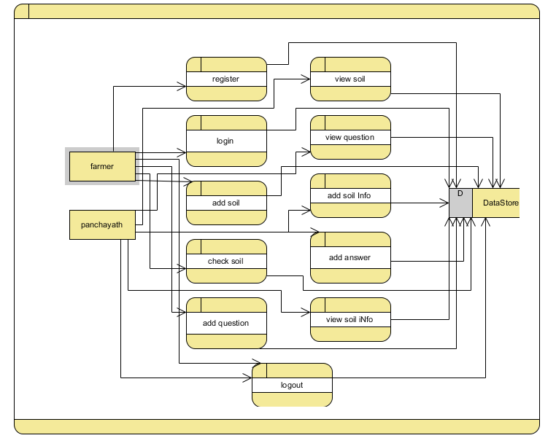
UML DIAGRAMS
Figure:Level-2 diagram

Slide 46
REFERENCES
[1] Viraj Patodkar1, Sujit Simant2, ShubhamSharma3, Chirag Shah4, Prof. Sachin Godse5, “EAgro Android Application (Integrated Farming Management Systems)”2015[1]
[2] Prof.P.B.Gaikwad, Pallavi Malode, Pooja Pawar, Sangita Darade, “E-Farming an Interface for Indian Farming” 2015[4]
[3] O. O. Mazhara, S. I. Shapovalovam ,“Production System for Express Diagnostics of the Agriculture and Natural Resources Objects for Portable Devices”2016[7]
[4] Aniket Bhave, Rahul Joshi, Ryan Fernandes, “Mahafarm An Andriod based solution for remunerative Agriculture” 2014[2]

Slide 47
REFERENCES
[5] Methodology: AMS-I.E.: Switch from Non-Renewable Biomass for Thermal Applications by the User Version 2.0 https://cdm.unfccc.int/methodologies/DB/4AWU125UNQL OC5JAMXQFU60KDCJNUA/vie w.html
[6] Cool Farm Alliance (2014): Cool Technical Documentation for the online Cool Farm Tool Cool Farm Institute (2013): Cool Farm Tool Online Manual https://app.coolfarmtool.org/static/doc/CFT_Online_Manu al_-_beta.pdf
[7] FAO (n.d). Farming Systems and Poverty. http://www.fao.org/farmingsystems/description_en.htm
[8] Gold Standard Agriculture Requirements, version 0.9 (2014): http://www.goldstandard.org/resources/agriculturerequirements

